Slide 1






AWS ECS Exec

Slide 2

Hello!
I am Khaja M Mohammed
I am here because I love to share knowledge and mostly around tech
You can find me at https://www.linkedin.com/in/khaja143/

Slide 3


Prerequisites for ECS Exec
Proposal and How Does ECS Exec work - Part 1
Proposal and How Does ECS Exec work - Part 2
Infrastructure configuration for ECS Exec
Baking security controls with IAM
Demo with AWS CLI on NGINX Container
Demo Reference Create Steps
Demo Reference Cleanup Steps
Amazon ECS Exec Checker
Containers Roadmap
Agenda

Slide 4
Prerequisites for ECS Exec
AWS Account
AWS CLI minimum version of 2.1.31+
IAM Roles and Policies
Basic ECS Knowledge
Basic understanding of Fargate
Basic understanding of SSM & AWS SSM Installed on the host machine from where the `ecs exec` command is run

Slide 5
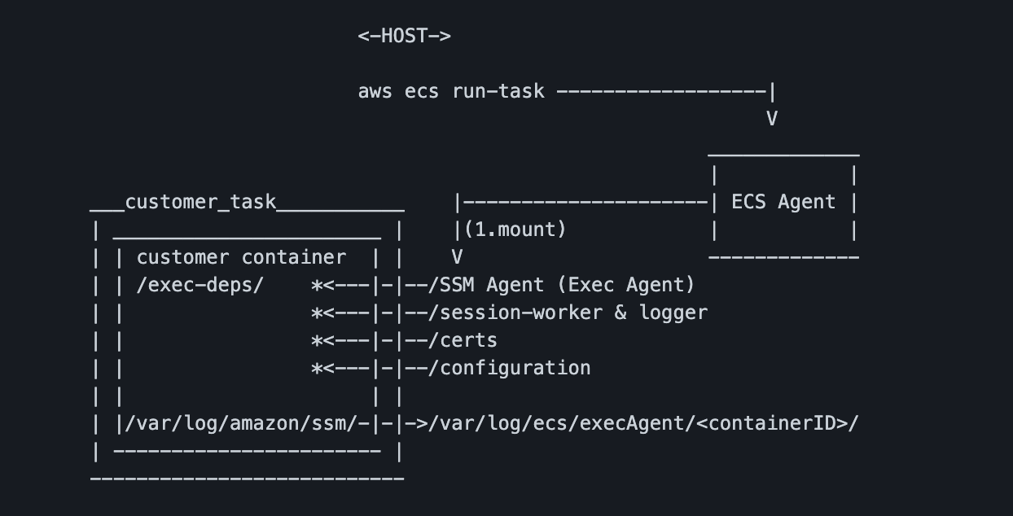
Proposal and How Does ECS Exec work - Part 1
[ECS] [Proposal]: ECS Execute-Command proposal #1050 https://github.com/aws/containers-roadmap/issues/1050
Note: Above Image used from https://github.com/aws/containers-roadmap/issues/1050

Slide 6
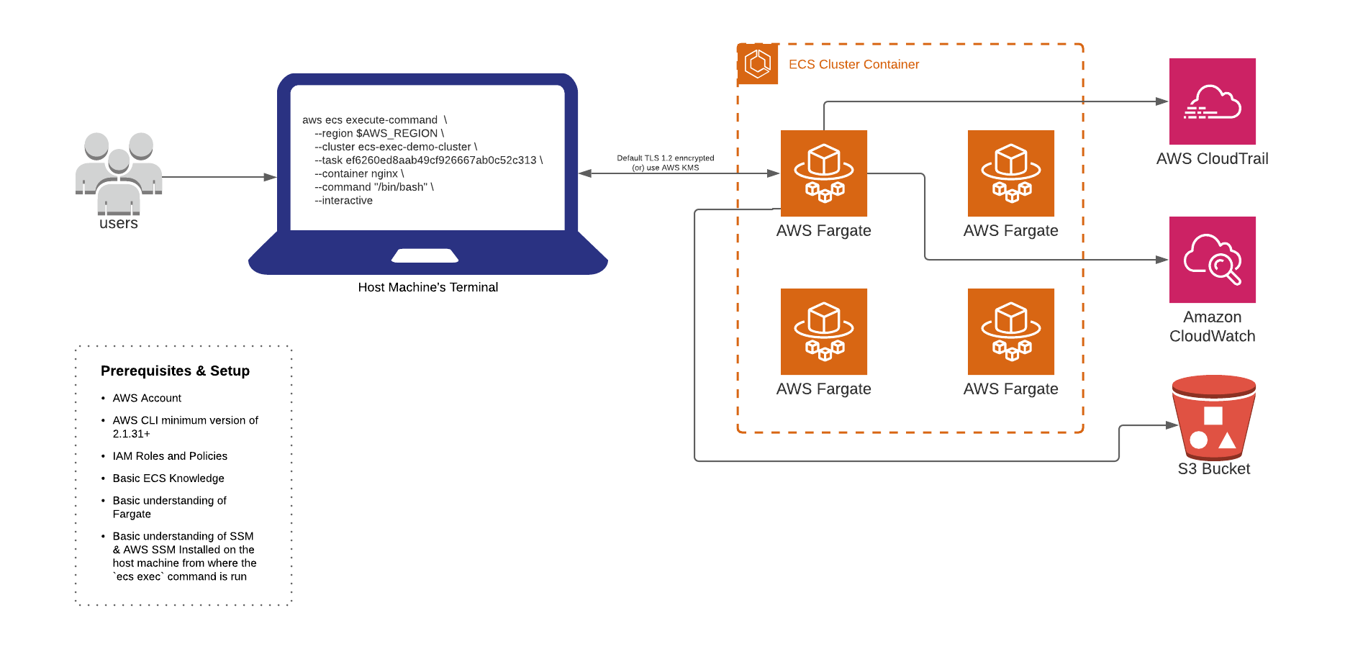
Proposal and How Does ECS Exec work - Part 2

Slide 7
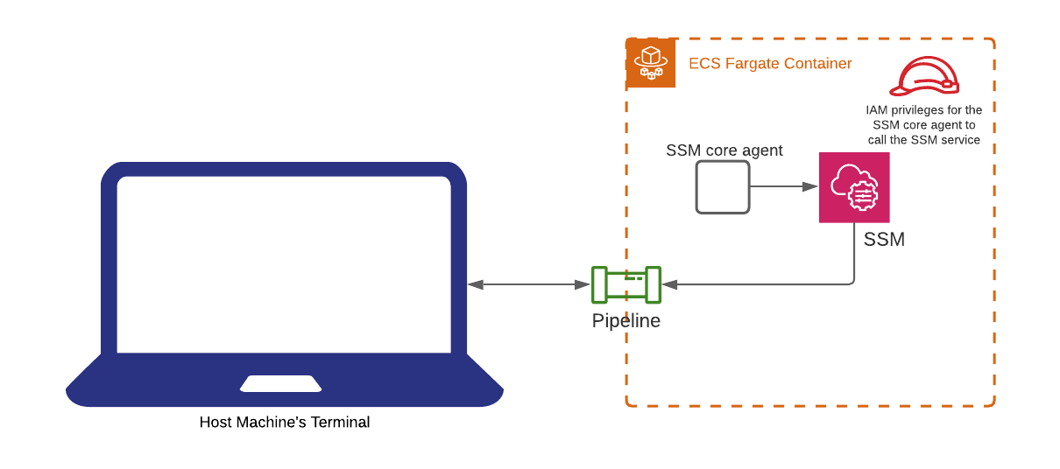
Infrastructure configuration for ECS Exec
`script` which is part of util-linux and `cat` which is part of coreutils should be installed and available in your container, the nginx container comes bundled with these scripts. This is important for logging purposes from within your container to Cloudwatch and/or S3 Bucket. We will see it’s importance when running the aws-cli command with the flag executeCommandConfiguration (this flag is available with aws-cli v2.1.31+)
Configuring the task role with the proper IAM policy

Slide 8
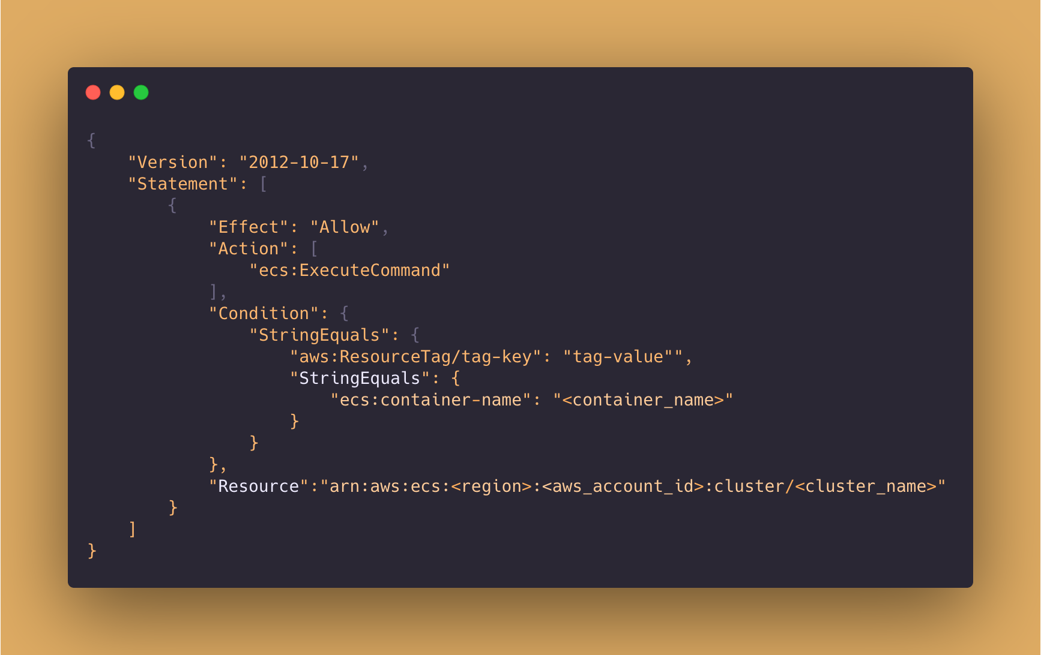
Baking security controls with IAM
A new IAM action is introduced `ecs:ExecuteCommand` to handle and provide fine grain controls from cluster to individual task levels in combination with ‘either ecs:ResourceTag/tag-key` and/or `aws:ResourceTag/tag-key`

Slide 9
Demo with AWS CLI on NGINX Container
http://bit.ly/ecs-exec

Slide 10
Demo Reference Create Steps
Step 1: Setup all required environment variables
Step 2: Create IAM Policy json file for ECS task role and ECS task execution role
Step 3: Create ecs cluster with new flag `executeCommandConfiguration`
Step 4: Create log group
Step 5: Create S3 Bucket
Step 6: Create Security group and enable ingress on port 80
Step 7: From the policy document (Step 2) create roles for `ecs-exec-demo-task-execution-role` and `ecs-exec-demo-task-role`
Step 8: Create a new policy for `ECS task role`, as we need to open a secure communication channel with the host machine, with the help of SSM
Step 9: Attach the policy `arn:aws:iam::aws:policy/service-role/AmazonECSTaskExecutionRolePolicy` to the role `ecs-exec-demo-task-execution-role` that we created in Step 7. But for the `ecs-exec-demo-task-role` attach (update) with the new policy we have created in Step 8.
Step 10: Create the task definition json file with the required container details and other metadata
Step 11: Register the task json file created in Step 10.
Step 12: Now create the ECS Cluster with all flags
Step 13: Fetch the `taskArn` from the output of the last command or run `aws ecs describe-tasks` and capture the task id.
Step 14: Finally, execute the command `aws ecs execute-command` with required flags, and if everything has gone successfully, we should now be inside an interactive shell of the container.
Step 15: If you have made any changes in the above step, you might want to see the output through curl and to do that you require the public ip of the container that you can get by running the command `aws ec2 describe-network-interfaces --network-interface-ids` and pass the network interface from the command output of `aws ecs describe-tasks`
Step 16: You always don’t need to exec into the container, but you can also run one off single commands like “ls” command.

Slide 11
Demo Reference Cleanup Steps
Step 1: Stop the task
Step 2: Delete the ECS Cluster
Step 3: Delete the log groups
Step 4: Mark the bucket for removal and then delete the S3 bucket
Step 5: Detach and delete the policy and roles created
Step 6: Delete the KMS Key
Step 7: Delete the Security Group

Slide 12
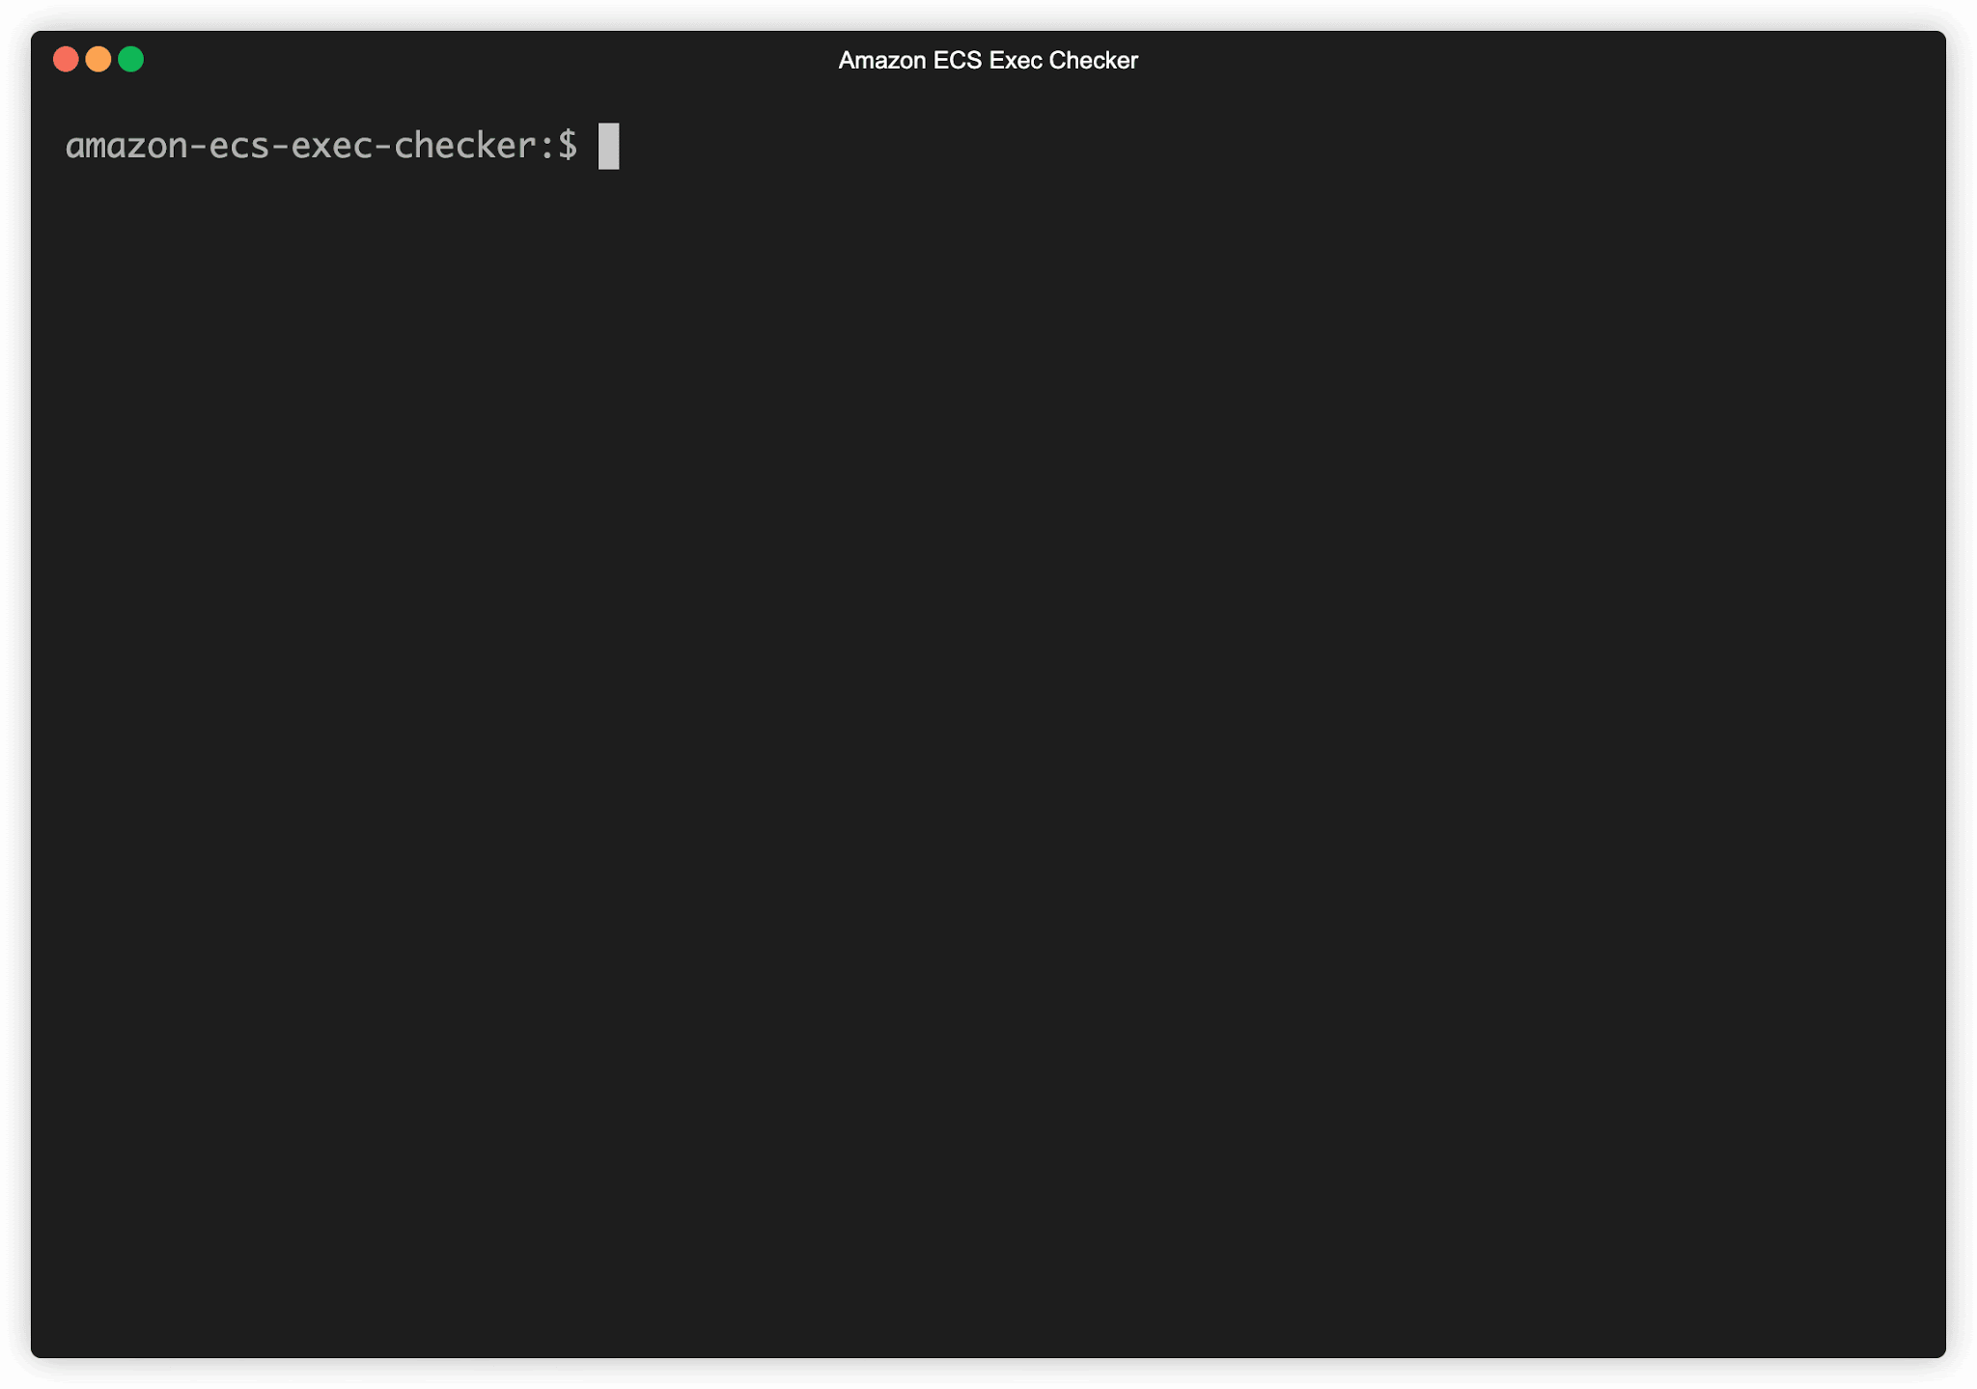
Amazon ECS Exec Checker

Slide 13
Containers Roadmap
https://github.com/aws/containers-roadmap

Slide 14

Thanks!
Any questions?
You can find me at LinkedIn

Slide 15
Glossary of Terms
ECS: Elastic Container Registry
IAM: Identity and access management
Fargate: Serverless and launch type of your containers.
AWS SSM: Simple Systems Manager

Slide 16
Resources
NEW – Using Amazon ECS Exec to access your containers on AWS Fargate and Amazon EC2
Container Roadmap https://github.com/aws/containers-roadmap
ECS Execute-Command proposal https://github.com/aws/containers-roadmap/issues/1050
Install the Session Manager plugin for the AWS CLI https://docs.aws.amazon.com/systems-manager/latest/userguide/session-manager-working-with-install-plugin.html
Amazon ECS Exec Checker https://github.com/aws-containers/amazon-ecs-exec-checker
ECS Exec User Docs https://docs.aws.amazon.com/AmazonECS/latest/developerguide/ecs-exec.html
Lucid Charts
Carbon
Random String Generator https://www.random.org/strings/?num=10&len=20&digits=on&loweralpha=on&unique=on&format=html&rnd=new

